Slide 1
Fake news detection system
UNDER THE ESTEEMED GUIDANCE OF
Dr. P. CHANDRASEKHAR REDDY
PROFESSOR
ECE DEPARTMENT, JNTUH
Presented by:
G. SAKETH (21011P0410)
P. VENKAT SAI (21011P0423)

Slide 2
Introduction
In this presentation, we’ll introduce our innovative approach to addressing the growing problem of misinformation in the digital age. Our Fake News Detection System, powered by advanced natural language processing (NLP) techniques, leverages the BERT model to accurately classify news articles as real or fake. By using state-of-the-art algorithms and contextual understanding, we aim to revolutionize how information credibility is assessed and validated.
As technology advances, our project aspires to empower individuals and organizations with tools to combat misinformation effectively. By automating the detection process and improving its accuracy, we hope to reduce the spread of fake news while fostering trust in media sources. Join us as we explore how this system can pave the way for a more informed and reliable digital world.

Slide 3
Aim:
To develop a machine learning model that accurately classifies news articles as "Real" or "Fake" using natural language processing and deep learning techniques.
Objectives:
Data Collection:
Collect datasets of real and fake news articles from multiple sources.
Data Preprocessing:
Clean and preprocess the text data by removing irrelevant columns, handling missing data, and applying text cleaning techniques (removing punctuation, converting text to lowercase, etc.).
Model Training:
Train a BERT-based classification model to classify news articles into real or fake categories.
Evaluation:
Evaluate the model’s performance using precision, recall, accuracy, and loss metrics to assess its effectiveness.
Prediction:
Make predictions on unseen articles and output their classification as real or fake.

Slide 4
Literature review
The lecture highlighted advancements in fake news detection using machine learning, NLP, and transformer models like BERT. Traditional methods like Naive Bayes and SVM analyze linguistic patterns, while BERT excels at understanding context and semantics. Data preprocessing and feature extraction were also discussed for improving detection accuracy.
Despite progress, the lecture stressed the need for scalable systems to tackle evolving misinformation. Combining BERT’s contextual understanding with data preprocessing and visualization techniques offers a robust solution, aiming for high precision in fake news detection and laying the groundwork for future innovations in combating misinformation.

Slide 5
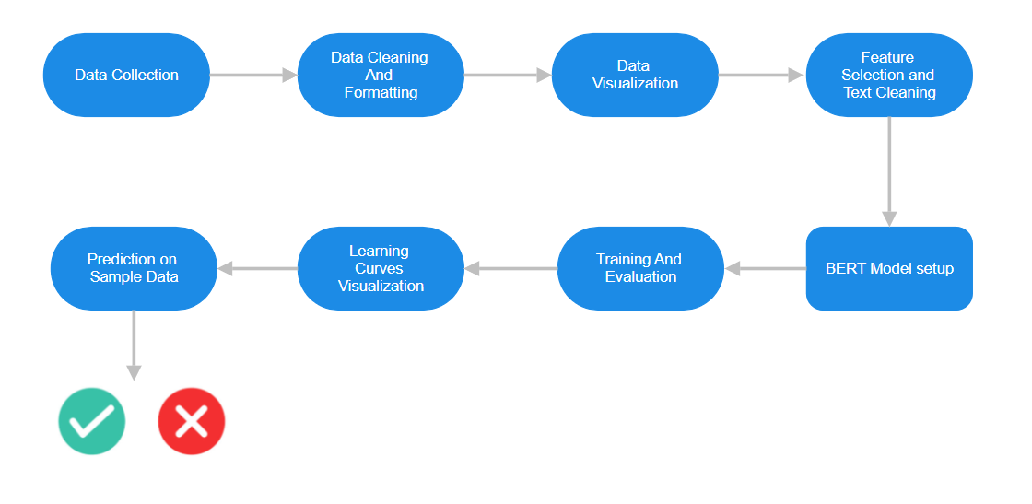
The System Flow

Slide 6

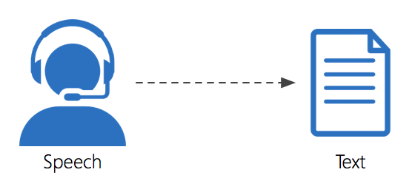


Data Collection
Efficiently collect news articles from specific sources to build a dataset for training the Fake News Detection System.
A CSV file was generated containing:
Headlines: The titles of the news articles.
Links: URLs for accessing the articles.
Snippets: Brief descriptions or summaries of the articles.
Used to fetch news articles from targeted sources like The Times of India based on specific queries.
Automated the retrieval and structuring of data into a CSV file.
Key Tools Used:
requests: Facilitates interaction with the Google Custom Search API by sending HTTP requests and retrieving responses.
pandas: Organizes data into a structured DataFrame.

Slide 7
Data Cleaning And Formatting
Handling Missing Data:
Rows with missing values in the "snippet" or "label" columns are removed to ensure that the dataset is complete and ready for analysis.
Filtering Valid Labels:
Only rows with valid label values of 0 or 1 are retained, ensuring that the dataset contains only the relevant data for classification (e.g., Real/Fake).
Data Type Conversion
The label column is converted to integer type, and the text column is converted to string type to prepare the data for processing and model training.

Slide 8
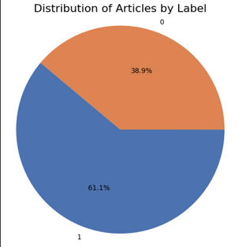
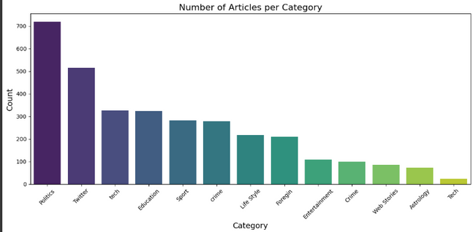
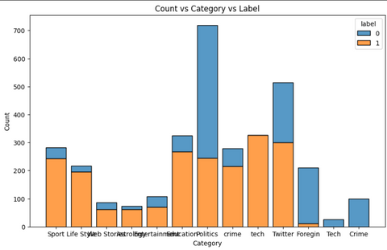
Data Visualization
Pie Chart: Label Distribution
Displays the proportion of articles labeled as "Fake" and "Real".
Highlights dataset balance to ensure fairness in model training.
Bar Chart: Articles per Category
Displays the number of articles in each category.
Identifies category-wise distribution to ensure diversity in training data.
Histogram: Count vs. Category vs. Label
Shows the distribution of articles across categories (e.g., Politics, Crime).
Differentiates between "Fake" and "Real" news for each category.

Slide 9


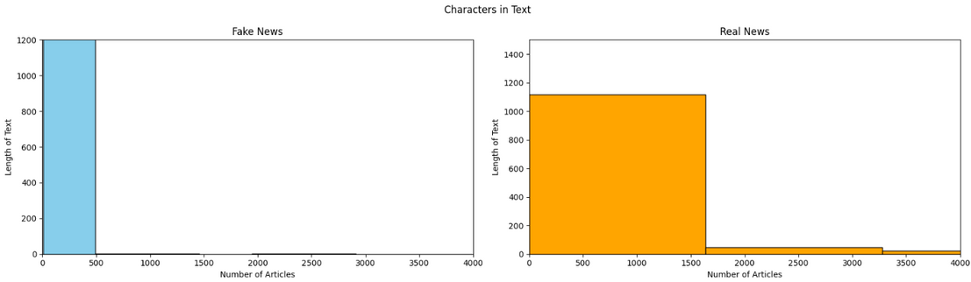
Wordcloud Visualization
Displays the most frequent words in the dataset for both "Fake" and "Real" articles.
Provides a quick overview of common terms, aiding in feature selection and preprocessing.
Text Length Analysis
Compares the character lengths of text for "Fake" and "Real" articles.
Helps understand linguistic differences, providing insights for preprocessing.

Slide 10
Feature Selection and Text Cleaning
Data Filtering:
Removing Irrelevant Columns:
The "Category", "headline", and "Date" columns are dropped from the dataset to focus on the most relevant features for model training.
This step helps in simplifying the dataset and ensuring the model uses only the necessary data.
Text Cleaning:
A custom function, text_cleaning, is applied to the "text" column.
The function removes all non-alphanumeric characters (such as punctuation) from the text, leaving only letters and numbers, which is a common preprocessing step in text-based machine learning tasks.

Slide 11

BERT MODEL
BERT (Bidirectional Encoder Representations from Transformers) is a pre-trained transformer-based model designed for natural language understanding tasks.
It captures contextual relationships between words in a sentence by considering both left and right context (bidirectional).
Model Configuration:
Model Class: ClassificationModel from the simpletransformers library, which simplifies using transformers for classification tasks.
Pre-trained Model: bert-base-cased, a variant of BERT that is case-sensitive and generally performs better for tasks that require distinguishing between different letter cases.
Using Pre-trained BERT:
Model Type: BERT ('bert-base-cased'), a pre-trained transformer model known for its strong performance on NLP tasks.

Slide 12
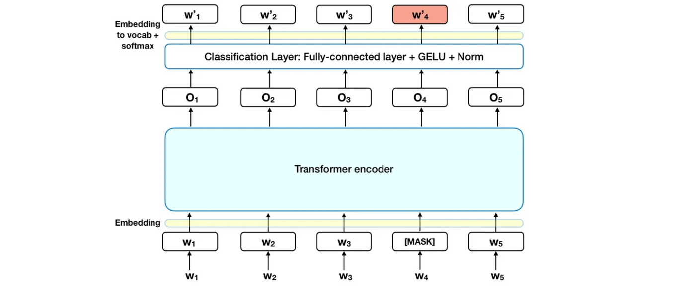
BERT Architechture

Slide 13


Data Splitting and Setup
Data Splitting:
The dataset is divided into two equal parts:
Training Set (50%): Used for training the model.
Evaluation Set (50%): Used for validating the model's performance during training.
Library Installation:
Installed the necessary tools and libraries for managing and training the BERT model.
Ensured compatibility by using a specific library version for smooth execution.

Slide 14
Model Initialization and Training
Model Initialization:
The pre-trained BERT model (bert-base-cased) is loaded for text classification.
Case-sensitive BERT variant helps process text while preserving its original case.
Training Process:
The model was trained using the Simple Transformers library, which handles model architecture, optimization.
The training is conducted over multiple epochs, using the prepared training and evaluation datasets.
A loss value is tracked during training to monitor the model’s progress.
Evaluation During Training:
The evaluation dataset is used to check the model's performance after each training epoch.
Metrics like evaluation loss are calculated to measure accuracy and guide improvements.

Slide 15
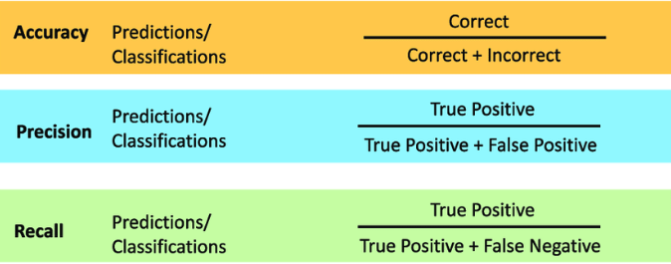
Performance Monitoring and Evaluation
Performance Tracking:
After each epoch, metrics such as precision, recall, accuracy, and evaluation loss were calculated and stored.
These metrics were logged to monitor trends and identify areas for improvement.
Key Metrics:
Precision:
Measures the proportion of correctly predicted fake or real news among all predictions.
Ensures the model is making accurate predictions for specific labels.
Recall:
Measures how many actual fake or real news articles the model successfully identified.
Reflects the model’s ability to capture all relevant cases.
Accuracy:
The overall proportion of correctly classified instances.
A general indicator of the model’s performance.

Slide 16
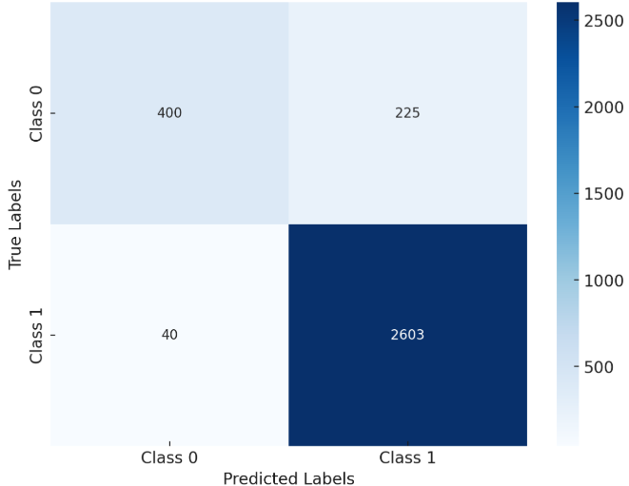
Confusion Metrix

Slide 17
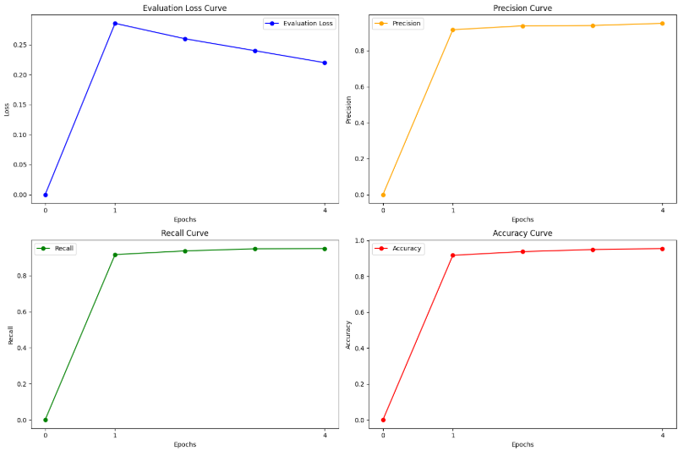
Learning Curve Visualization

Slide 18
Prediction Using the Trained Model
Purpose of Text Preprocessing:
Remove unwanted characters, symbols, and punctuation to retain meaningful text for analysis.
Ensure the text is clean and standardized before feeding it into the model.
Input Preparation:
The cleaned text is converted into a format suitable for the model (a list of strings).
Model Prediction:
The preprocessed text is passed to the trained BERT model for classification.
The model outputs:
Prediction: Indicates whether the news is Real or Fake.
Raw Outputs: Confidence scores for the prediction.

Slide 19
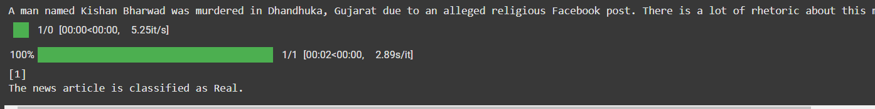
Predicted Output
Result Interpretation:
If Output = 1: The article is classified as "Real."
If Output = 0: The article is classified as "Fake.”
Example:
Input: "A man named Kishan Bharwad was murdered in Dhandhuka, Gujarat due to an alleged religious Facebook post. There is a lot of rhetoric about this murder case…"
Output: "Real News"

Slide 20
Limitations
Dependence on Quality Data: Model performance is limited by the availability and quality of labeled data, especially for emerging or regional topics.
Handling Complex Language: The model may struggle with detecting subtle misinformation, sarcasm, or context-based nuances in news articles.
Scalability Issues: Real-time detection at a large scale requires significant computational resources, which could limit deployment in resource-constrained environments.
Potential Biases: If the training data contains biases, the model may inadvertently propagate them, leading to skewed predictions or unfair classification.
Evolving Misinformation Tactics: As fake news creators adapt and use more sophisticated techniques (e.g., deepfakes, manipulated media), the model may need continuous updates to stay effective against new types of misinformation.

Slide 21
Future Prospects
Real-Time Implementation: Integrate the model into social media or news platforms to detect misinformation.
Build tools for automated fact-checking within online content and news websites.
Research and Innovation:Explore integration with emerging technologies like blockchain for transparent content provenance tracking.
Incorporate sentiment analysis and emotion detection to analyze the intention behind fake news.
Model Enhancement: Expand datasets to include multilingual content and incorporate advanced techniques like hyperparameter tuning and ensemble methods to improve accuracy.
User Engagement and Feedback Loop: Incorporate a user feedback loop to continuously improve the model, where users can flag false positives/negatives, helping retrain the system.
Collaboration with News Agencies: Collaborate with media companies to create tools for journalists that help detect fake news at the source

Slide 22
References
Rahul Chauhan, Sachin Upadhyay and Himadri Vaidya titled “Fake News Detection based on machine learning algorithm”
A Comprehensive Notebook on Fake News Prediction
https://www.kaggle.com/code/muhammadimran112233/a-comprehensive-notebook-on-fake-news-prediction#21.-Report:-Results
Detecting Fake News — with a BERT Model
https://medium.com/@skillcate/detecting-fake-news-with-a-bert-model-9c666e3cd
Fake news classification
https://www.kaggle.com/code/sanskrutikunjir/fake-news-classification

Slide 23
Thank You

Slide 24
QUESTIONS?

